Slide 1
Lab 10
Latch / Flip-Flop

Slide 2
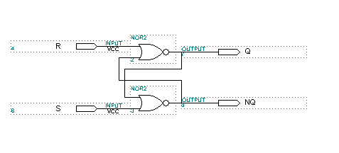
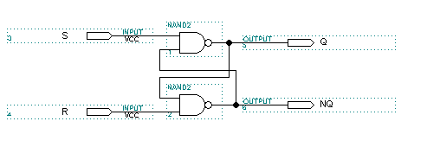
S-R LATCH

Slide 3
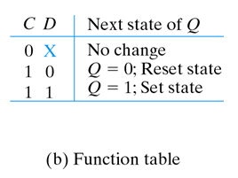
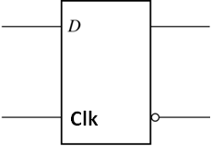
GATED D LATCH
D
S
(Data)
Q
C
Q
R

Slide 4
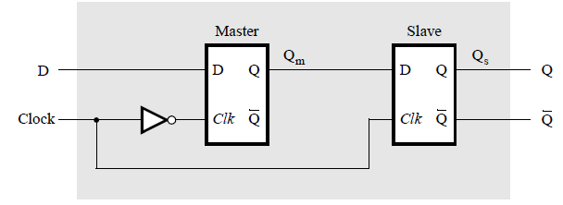
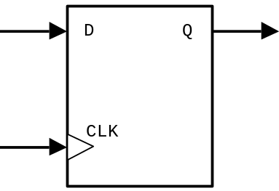
POSITIVE EDGE-TRIGGERED D FLIP-FLOP
CLK
D
Q(t+1)
0
X
Q(t)
1
X
Q(t)
↑
1
1
↑
0
0

Slide 5
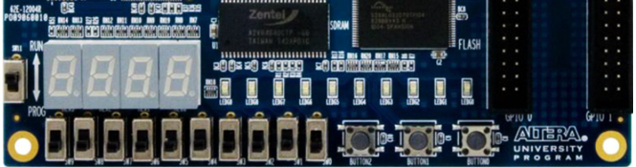
EXPERIMENT STEP (1):
We will show how storage elements can be created in an FPGA without using its dedicated latches.
In Quartus II, generate a schematic diagram of gated D latch, as shown on page 3.
Verify that the latch works properly for all input conditions by using functional simulation
Compile your project and download the compiled circuit onto the DE0 board
Test the functionality of your circuit by toggling the D and Clk switches and observing the Q output
D
Clk
Q

Slide 6
EXPERIMENT STEP (2):
We will show how storage elements can be created in an FPGA without using its dedicated flip-flops.
In Quartus II, generate a schematic diagram of master-slave D flip-flop, as shown on page 4.
Verify that the flip-flop works properly for all input conditions by using functional simulation
Compile your project and download the compiled circuit onto the DE0 board
Test the functionality of your circuit by toggling the D and Clk switches and observing the Q output
D
Clk
Q

Slide 7
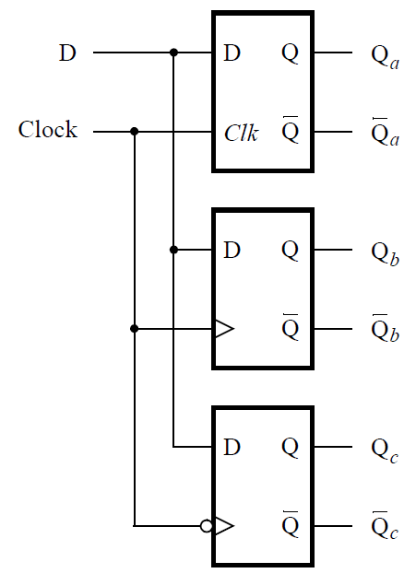
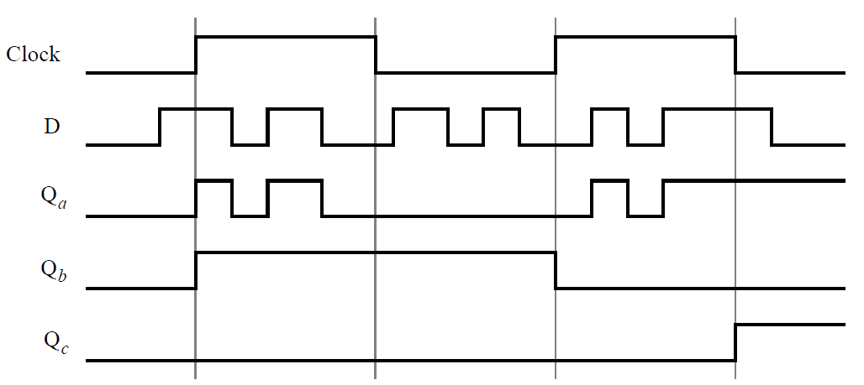
EXPERIMENT STEP (3):
This time we will use the FPGA’s dedicated storage elements
In Quartus II, generate a schematic diagram of the circuit, as shown below.
Use functional simulation to obtain the three output signals, Qa, Qb, Qc. Observe the different behavior of the three storage elements

